Slide 1
Mobile application developement
Internship report
Student : Hani Ouni
Host organisation : Mind engineering
college year : 2016-2017

Slide 2
Plan
Introduction
Project context
Requirements Analysis And application design
Development
Internship Achievements
Conclusion

Slide 3
Introduction

Slide 4
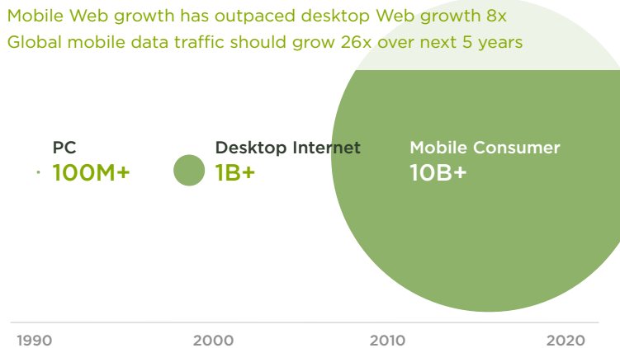
Introcuction 1/3
Growth = opportunity :
Mobile first – Luke wroblowski

Slide 5
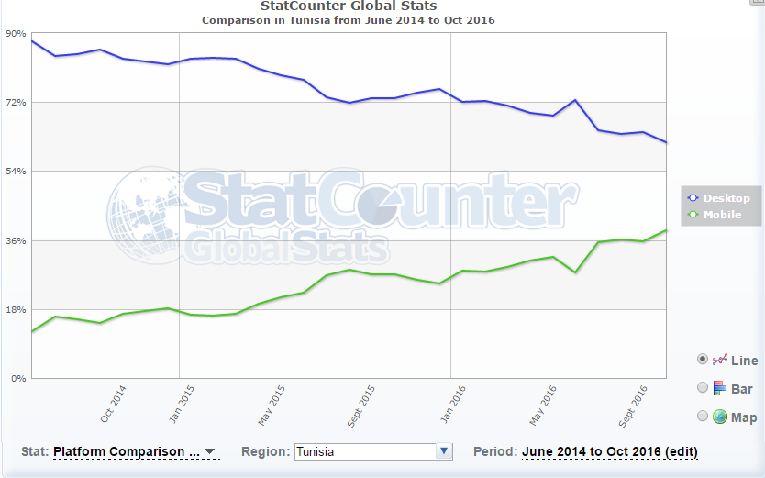
Introduction 2/3
Growth = opportunity
http://gs.statcounter.com/

Slide 6
Introduction 3/3
To massive growth of mobile users added to the simplicity of using mobile devices and the portability advantage is a very huge to reason to make everyone thinks about adopting the solution and building his own mobile app .
News websites in particular should adopt this solution beacause of the various advantages offered by mobile plateforms (push notification service for example ) ,

Slide 7
Prject context

Slide 8
Summer intership

Slide 9
Introduction 2/3

Slide 10
Introduction 2/3

Slide 11
Introduction 2/3

Slide 12
Introduction 2/3

Slide 13
Introduction 2/3

Slide 14
Introduction 2/3

Slide 15
Introduction 2/3

Slide 16
Introduction 2/3

Slide 17
Introduction 2/3

Slide 18
Introduction 2/3

Slide 19
Introduction 2/3

Slide 20
Introduction 2/3

Slide 21
Introduction 2/3

Slide 22
Introduction 2/3

